Slide 1
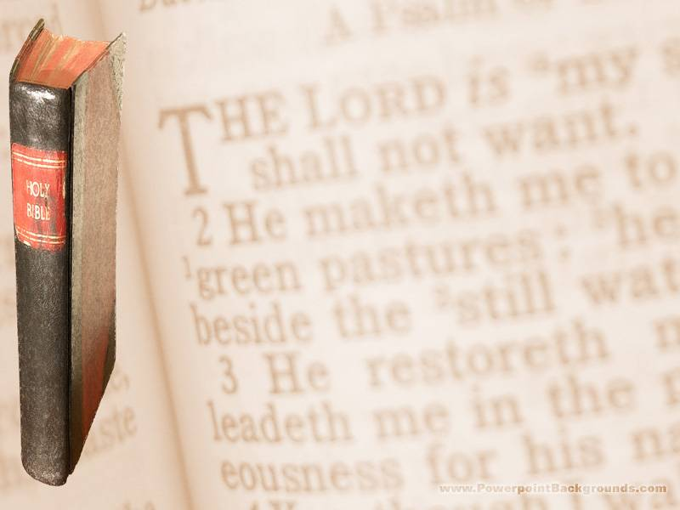
Luke 10:38-42 Now it came to pass, as they went, that he entered into a certain village: and a certain woman named Martha received him into her house. And she had a sister called Mary, which also sat at Jesus' feet, and heard his word. But Martha was cumbered about much serving, and came to him, and said, Lord, dost thou not care that my sister hath left me to serve alone? bid her therefore that she help me. And Jesus answered and said unto her, Martha, Martha, thou art careful and troubled about many things: But one thing is needful: and Mary hath chosen that good part, which shall not be taken away from her.

Slide 2
Worship- “WHAT”
Worshipper- “WHO”
Worshipping- “HOW”

Slide 3
John 4:21-23 Jesus saith unto her, Woman, believe me, the hour cometh, when ye shall neither in this mountain, nor yet at Jerusalem, worship the Father. Ye worship ye know not what: we know what we worship: for salvation is of the Jews. But the hour cometh, and now is, when the true worshippers shall worship the Father in spirit and in truth: for the Father seeketh such to worship him.

Slide 4
Worship- “WHAT”
Worshipper- “WHO”
Worshipping- “HOW”

Slide 5
Worshipper- “WHO”
Shall…ASCEND
Shall…STAND
Shall…ABIDE
Shall…DWELL

Slide 6
Worshipper- “WHO”
Shall…ASCEND… into the hill of the Lord
Shall…STAND…in his holy place
Shall…ABIDE…thy tabernacle
Shall…DWELL…thy holy hill

Slide 7
The
“Anato-ME” of a
Worshipper

Slide 8
The
“Anato-ME” of a
Worshipper
“WHO” The HANDS of a TRUE Worshipper

Slide 9
The
“Anato-ME” of a
Worshipper
“WHO” The HANDS of a TRUE Worshipper
Clean HANDS

Slide 10
Job 16:17 Not for any injustice in mine hands: also my prayer is pure.

Slide 11
Ezekiel 23:37 That they have committed adultery, and blood is in their hands, and with their idols have they committed adultery, and have also caused their sons, whom they bare unto me, to pass for them through the fire, to devour them.

Slide 12
The
“Anato-ME” of a
Worshipper
“WHO” The HANDS of a TRUE Worshipper

Slide 13
The
“Anato-ME” of a
Worshipper
“WHO” The HANDS of a TRUE Worshipper
Clean HANDS

Slide 14
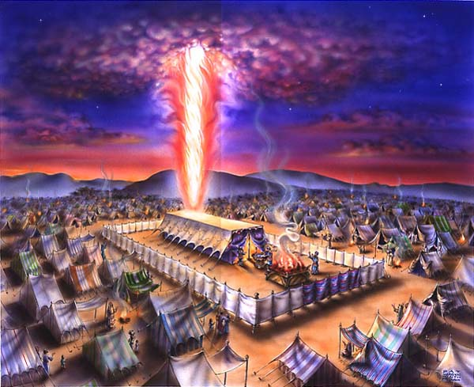

Slide 15
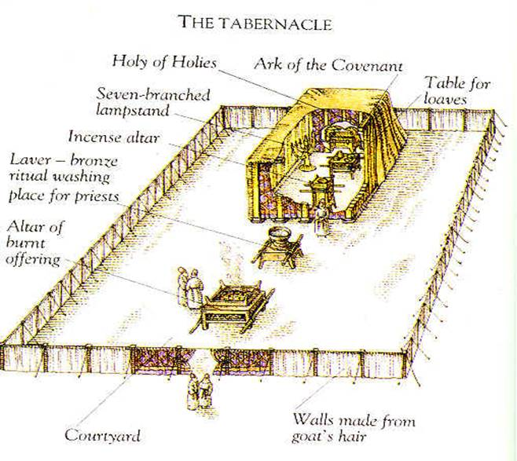

Slide 16
1 Peter 2:9 But ye are a chosen generation, a royal priesthood, an holy nation, a peculiar people; that ye should shew forth the praises of him who hath called you out of darkness into his marvellous light
Hebrews 13:15 By him therefore let us offer the sacrifice of praise to God continually, that is, the fruit of our lips giving thanks to his name.

Slide 17
The
“Anato-ME” of a
Worshipper
“WHO” The HANDS of a TRUE Worshipper
Clean HANDS

Slide 18
Matthew 6:24 No man can serve two masters: for either he will hate the one, and love the other; or else he will hold to the one, and despise the other. Ye cannot serve God and mammon.

Slide 19
Luke 15:20 And he arose, and came to his father. But when he was yet a great way off, his father saw him, and had compassion, and ran, and fell on his neck, and kissed him.

Slide 20
The
“Anato-ME” of a
Worshipper
“WHO” The HANDS of a TRUE Worshipper
Clean HANDS

Slide 21
The
“Anato-ME” of a
Worshipper
“WHO” The HANDS of a TRUE Worshipper
Uplifted HANDS

Slide 22
Lamentations 3:41 Let us lift up our heart with our hands unto God in the heavens.

Slide 23
1 Timothy 2:8 I will therefore that men pray every where, lifting up holy hands, without wrath and doubting.

Slide 24
The
“Anato-ME” of a
Worshipper
“WHO” The HANDS of a TRUE Worshipper

